Slide 1

Exploring and Analyzing Diabetes Data Through Statistical Techniques in R
Yasmin Almeida Ferrera MSc Artificial Intelligence Module : Numerical Analysis MODULE TUTOR : Ali Edisen University of Essex July 2026

Slide 2
Study Objectives
Objectives
Explore the demographic and clinical characteristics of the diabetes dataset.
Examine the relationship between diabetes and key risk factors.
Evaluate statistical associations using hypothesis testing.
Develop regression models to predict glucose levels and diabetes outcome.
Statistical Methods
Descriptive Statistics
Data Visualisation
Hypothesis Testing
Correlation Analysis
Linear Regression
Logistic Regression
Aim: To identify the main predictors of diabetes and evaluate their statistical significance.
"Statistics is the art and science of learning from data."
(RSS International, 2024)

Slide 3

Dataset Description
Variable | Description
Pregnancies | N of pregnancies
Glucose | Plasma glucose concentration
Blood Pressure | Diastolic blood pressure
Skin Thickness | Triceps skinfold thickness
Insulin | Serum insulin
BMI | Body Mass Index
DiabetesPedigreeFunction | Diabetes family history score
Age | Age in years
Outcome | 0 = no diabetes 1 = diabetes
Dataset: Pima Indians Diabetes Database
Source: National Institute of Diabetes and Digestive and Kidney Diseases (NIDDK)
768 observations
8 predictor variables
1 binary response variable (Outcome)
https://www.kaggle.com/datasets/akshaydattatraykhare/diabetes-dataset/data
dim(diabetes)
names(diabetes)
str(diabetes)

Slide 4

Methodology
"…make both calculations and graphs. Both sorts of output should be studied; each will contribute to understanding." Anscombe (1973)
Descriptive Statistics
Import Dataset
Data exploration
Exploratory Visualisation
Hypothesis Testing
Regression Models
Model Evaluation
library(ggplot2) library(dplyr)

Slide 5
Sample Caractheristics
Characteristic | Value
Participants | 768
Variables | 9
No Diabetes | 500 (65.1%)
Diabetes | 268 (34.9%)
ggplot(diabetes,
aes(x = factor(Outcome))) +
geom_bar(fill = "#2E86C1") +
labs(title = "Distribution by Diabetes Status")

Slide 6
Summary Statistics
Table 1. Descriptive statistics of the main clinical variables.
Glucose showed the greatest variability.
BMI and Age were widely distributed.
Summary statistics guided subsequent analyses.
Variable | Mean | Median | SD | Min | Max
Glucose | 120.89 | 117 | 31.97 | 0 | 199
BMI | 31.99 | 32.0 | 7.88 | 0.0 | 67.1
Age | 33.24 | 29 | 11.76 | 21 | 81
Blood Pressure | 69.11 | 72 | 19.36 | 0 | 122
Pregnancies | 3.85 | 3 | 3.37 | 0 | 17
.
From the Royal College of Radiologists guide:
Descriptive statistics summarise the data before more advanced analyses.
summary(diabetes)
describe(diabetes)

Slide 7
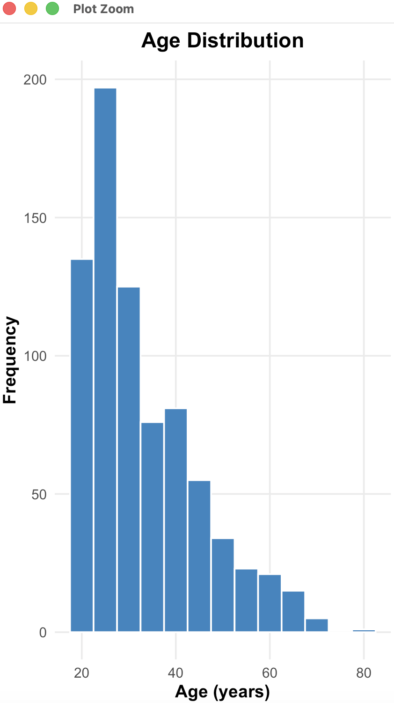
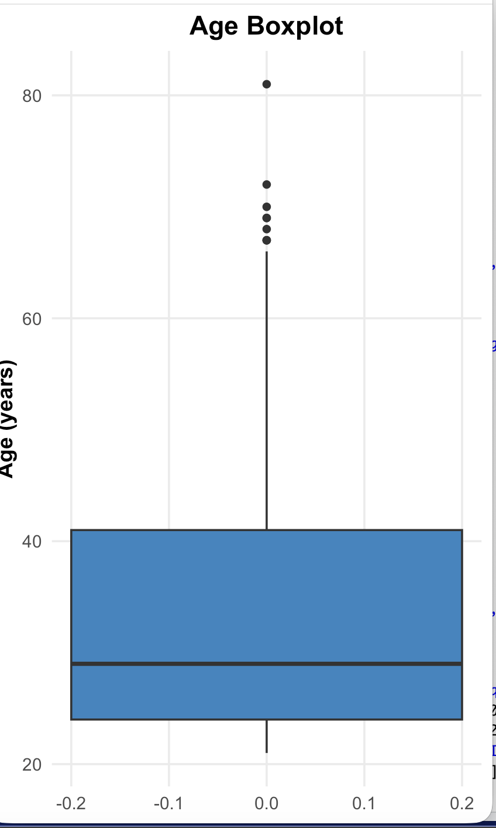
Age Distribution
• Most participants were between 21 and 41 years.
• Median age was 29 years.
• Age distribution was positively skewed.
• Several older participants (>65 years) were identified as outliers.
Q1 | 24
Median | 29
Q3 | 41
Max | 81
IQR | 17
ggplot(diabetes, aes(x = Age)) + geom_histogram()
ggplot(diabetes, aes(y = Age)) + geom_boxplot()
Autodesk article:
Similar summary statistics can hide different underlying distributions, highlighting the importance of visualising the data.

Slide 8
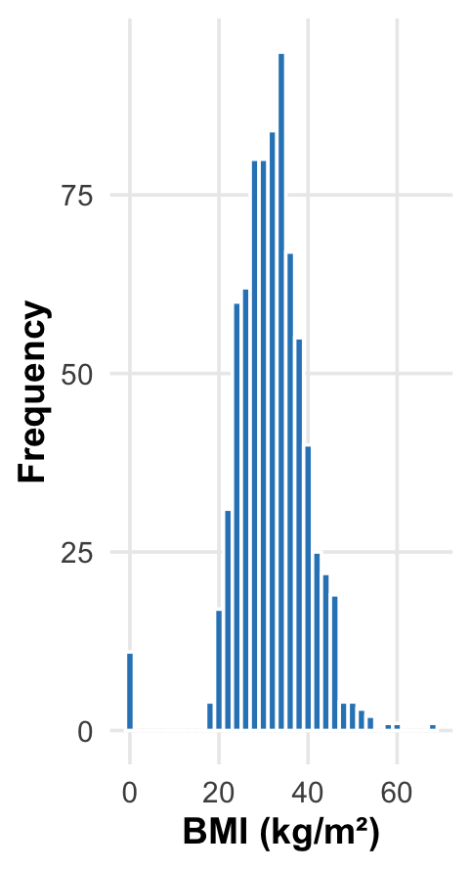
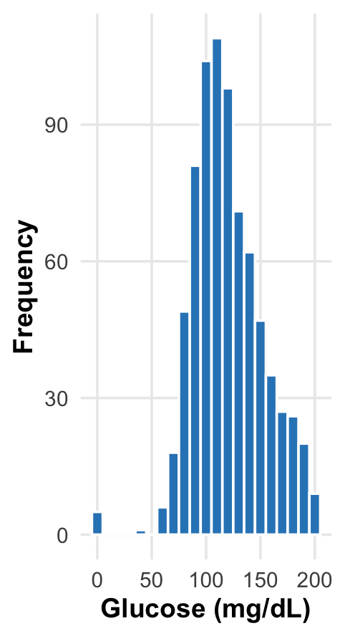
BMI and Glucose Distribution
Key Findings
• BMI is concentrated around 30–35 kg/m².
• Glucose shows greater variability than BMI.
• Both variables exhibit right-skewed distributions.
ggplot(diabetes, aes(x = BMI)) + geom_histogram()
ggplot(diabetes, aes(x = Glucose)) + geom_histogram()

Slide 9
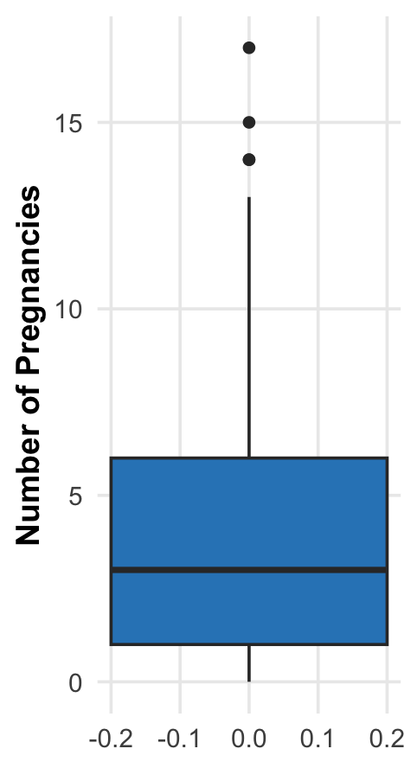
Blood pressure and pregnancies
Key Findings
• Pregnancies shows a positively skewed distribution with several high-value outliers (14–17 pregnancies).
• Blood Pressure contains impossible values (0 mmHg), suggesting missing values were encoded as zero.
• These observations indicate that data cleaning should be considered before predictive modelling.
• Boxplots provide a simple way to detect unusual observations that may influence statistical analyses.
ggplot(diabetes, aes(y = Pregnancies)) +
geom_boxplot(fill = "steelblue") +
labs(title = "Pregnancies Boxplot")
ggplot(diabetes, aes(y = BloodPressure)) +
geom_boxplot(fill = "steelblue") +
labs(title = "Blood Pressure Boxplot")

Slide 10
Diabetes Rates Across Age and BMI Categories
# Create age groups
diabetes$AgeGroup <- cut(
diabetes$Age,
breaks = c(20, 29, 39, 49, Inf),
labels = c("<30", "30-39", "40-49", "50+")
)
# Create BMI categories
diabetes$BMICategory <- cut(
diabetes$BMI,
breaks = c(-Inf, 18.5, 25, 30, Inf),
labels = c("Underweight", "Normal",
"Overweight", "Obese")
)
# Calculate diabetes rates
prop.table(table(diabetes$AgeGroup,
diabetes$Outcome), 1)
prop.table(table(diabetes$BMICategory,
diabetes$Outcome), 1)
Diabetes prevalence generally increased with age and BMI, with the highest prevalence observed among participants aged 40–49 and those classified as obese.

Slide 11
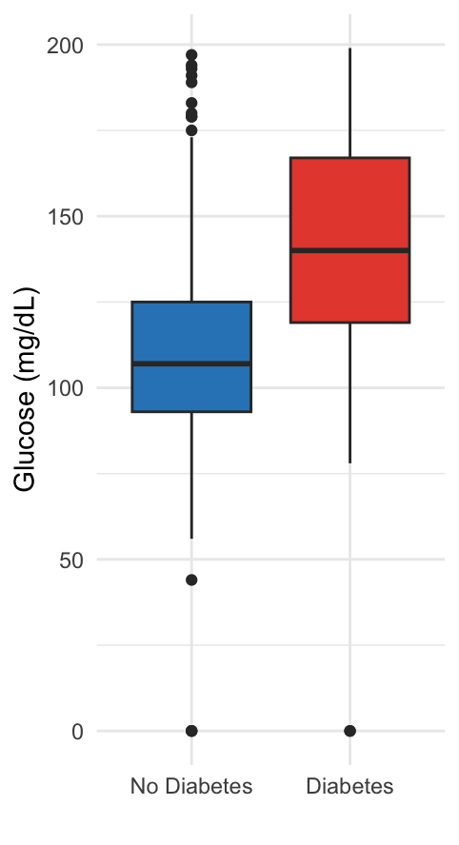
Glucose Levels by Diabetes Outcome
Key Findings
• Participants with diabetes had substantially higher glucose levels.
• Mean glucose increased from 110 to 141 mg/dL.
• The difference was statistically significant (p < 0.001).
ggplot(diabetes, aes(x = factor(Outcome, labels = c("No Diabetes","Diabetes")), y = Glucose, fill = factor(Outcome))) + geom_boxplot() + labs(title = "Glucose Levels by Diabetes Outcome", x = "", y = "Glucose (mg/dL)") + theme_minimal() + theme(legend.position = "none")
t.test(Glucose ~ Outcome, data = diabetes)

Slide 12
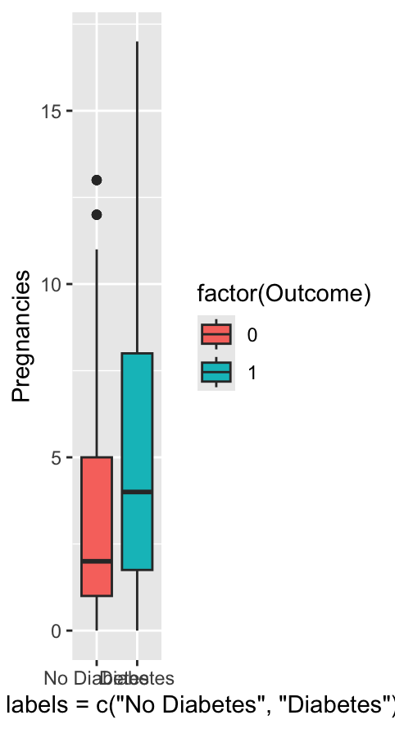
Pregnancies by Diabetes Outcome
# Pregnancy groups
diabetes$PregnancyGroup <- cut(
diabetes$Pregnancies,
breaks = c(-1, 0, 2, 4, Inf),
labels = c("0", "1-2", "3-4", "5+")
)
# Diabetes rates
prop.table(
table(diabetes$PregnancyGroup,
diabetes$Outcome), 1
)
# Group comparison
t.test(Pregnancies ~ Outcome,
data = diabetes)
Key Findings
Mean pregnancies: 4.87 vs 3.30
Significant difference (p < 0.001)
Highest diabetes rate in 5+ pregnancies (47.8%)

Slide 13
Correlation Matrix
Key Findings
Glucose shows the strongest positive association with Outcome.
BMI and Age exhibit moderate positive relationships.
No strong correlations (>0.70) were observed, indicating low multicollinearity among predictors.
The correlation analysis provides the basis for the regression models presented next.
cor_matrix <- cor(diabetes)
round(cor_matrix, 2)

Slide 14
Hypothesis Testing
Analysis | Test | Statistic | P-value | Decision
Diabetesx age groups | Chi-square | χ² = 69.92 | <0.001 | Reject H₀
DiabetesxBMI Categories | Chi-square | χ² = 76.43 | <0.001 | Reject H₀
Glucose by Age Groups | ANOVA | F = 19.62 | <0.001 | Reject H₀
Post-hoc (Tukey HSD)
50+ years had significantly higher glucose levels ( p < 0.01).
30-39 and 40-49 years showed no significant difference (p = 0.998).
chisq.test(table(diabetes$AgeGroup, diabetes$Outcome))
chisq.test(table(diabetes$BMICategory, diabetes$Outcome))
anova_model <- aov(Glucose ~ AgeGroup, data = diabetes)
summary(anova_model)
TukeyHSD(anova_model)
Diabetes prevalence differed significantly across age and BMI categories. In addition, older participants (50+) had significantly higher mean glucose levels than younger participants.

Slide 15
Multiple Linear Regression
Significant Predictors
Model Performance
Predictor | β Estimate | p-value | Significant
Age | +0.645 | <0.001 | ☑️
BMI | +0.750 | <0.001 | ☑️
Insulin | +0.100 | <0.001 | ☑️
Skin Thickness | -0.334 | <0.001 | ☑️
DPF | +6.316 | 0.046 | ☑️
Pregnancies | +0.059 | 0.871 | ❌
Blood Pressure | +0.070 | 0.220 | ❌
Metric | Result
Observations | 768
R² | 0.230
Adjusted R² | 0.223
F-statistic | 32.46
Model p-value | < 0.001
Model significant (p < 0.001)
R² = 23%
Age, BMI, Insulin and DPF were significant predictors
linear_model <- lm(
Glucose ~ Age + BMI + Pregnancies +
BloodPressure + SkinThickness +
Insulin + DiabetesPedigreeFunction,
data = diabetes
)
summary(linear_model)

Slide 16
Logistic Regression
Model Results
Model Performance
Predictor | Odds Ratio | P-value | interpretation
BMI | 1.09 | <0.001 | Higher BMI increases diabetes risk
Age | 1.03 | <0.001 | Older age increases diabetes risk
Glucose | 1.03 | <0.001 | Higher glucose increases diabetes risk
Metric | Result
Hosmer-Lemeshow t | P = 0.349
Classification Accuracy | 76.8%
Sensitivity | 56.3%
Specificity | 87.8%
hoslem.test(diabetes$Outcome,
fitted(log_model))
predicted <- ifelse(
predict(log_model, type = "response") > 0.5,
1, 0
)
All three predictors (BMI, Age and Glucose) were statistically significant.
The Hosmer–Lemeshow test was not significant (p = 0.349), indicating that the model fits the data adequately.
The model correctly classified 76.8% of participants.
The model identified 87.8% of non-diabetic individuals (high specificity) but only 56.3% of diabetic individuals(moderate sensitivity).
log_model <- glm(
Outcome ~ BMI + Age + Glucose,
data = diabetes,
family = binomial
)
summary(log_model)

Slide 17
Model Comparison
Logistic Models
Likelihood Ratio Test
Odds Ratios (Model 2)
Model | Predictors
Model 1 | BMI+Age+Glucose+Pregnancies
Model 2 | BMI+Age+Glucose+Pregnancies+BMIxAge
Test | Result
χ² | 0.039
P-value | 0.843
Decision | Interaction not significant
Predictor | OR | P-value
BMI | 1.08 | 0.064
Age | 1.01 | 0.871
Glucose | 1.03 | <0.001
Pregnancies | 1.12 | <0.001
BMI x Age | 1.00 | 0.843
Adding the BMI × Age interaction did not improve the model (Likelihood Ratio Test: p = 0.843).
The interaction term was not statistically significant.
Glucose and Pregnancies remained significant predictors.
Model 1 was preferred because it was more parsimonious while providing a similar fit.
model1 <- glm(
Outcome ~ BMI + Age + Glucose + Pregnancies,
family = binomial,
data = diabetes
)
model2 <- glm(
Outcome ~ BMI * Age + Glucose + Pregnancies,
family = binomial,
data = diabetes
)
anova(model1, model2, test = "Chisq")

Slide 18
Discussion
Age and diabetes
Older adults had higher glucose levels and higher diabetes prevalence, consistent with previous epidemiological studies.
Key Findings
Diabetes prevalence increased with age and BMI.
Individuals with diabetes had significantly higher glucose levels.
Women with diabetes reported more pregnancies on average.
Glucose, BMI and Age were significant predictors of diabetes.
The BMI × Age interaction was not statistically significant.
BMI as a risk factor
Higher BMI significantly increased diabetes risk, supporting evidence that obesity is a major contributor to Type 2 diabetes.
Glucose
Glucose was the strongest predictor in both regression models, which agrees with established clinical knowledge.
Comprehensive statistical analysis helps identify patterns and relationships within health datasets, improving interpretation and supporting evidence-based conclusions.

Slide 19

Limitations & Future Work
Future Work
Limitations
✔ Data cleaning & missing value imputation
✔ Additional clinical & lifestyle variables
✔ Machine learning models (Random Forest, XGBoost)
✔ External dataset validation
❌ Zero values treated as real observations
❌ Cross-sectional dataset
❌ Limited predictor variables
❌ Moderate model performance (R² = 23%)
Future studies should use larger, cleaner datasets and more advanced predictive models.

Slide 20
Conclusion
768 participants were analysed.
34.9% were diagnosed with diabetes.
Age, BMI and Glucose were the strongest factors associated with diabetes.
Significant differences were found in glucose levels and number of pregnancies between diabetic and non-diabetic individuals.
Logistic regression achieved 76.8% classification accuracy.
Key Findings
Statistical modelling successfully identified key diabetes risk factors and demonstrated the value of regression techniques for healthcare data analysis.

